Slide 1
Addiction and the Teenage Brain
Learning Target: I can explain how addictive substances work in the brain, creating tolerance, dependence and addiction.
Do Now: Each table write one question about addictive substances (tobacco, alcohol, illegal drugs and prescription drug abuse) on the board. Sign your name, no repeats.

Slide 2
How do addictive substances interact with your brain?
Short term: They raise the levels of dopamine and serotonin (feelings of pleasure and well-being).
Longer-term: They lower dopamine and serotonin levels.
Notes:
What common mental disorder is connected to lower levels of serotonin?

Slide 3
These Addictive Substances Increase Dopamine and/or Serotonin Levels
Dopamine
Opiates (heroin, Oxycontin, Vicodin)
Alcohol causes excessive dopamine release
Nicotine slows dopamine breakdown
Serotonin
Amphetamines, MDMA and Ecstasy (MDMA + other random substances) cause excessive serotonin release

Slide 4
PSYCHOACTIVE DRUGS | UPPERS / STIMULANTS | DOWNERS / DEPRESSANTS | ALL-AROUNDERS
EXAMPLES | Caffeine, nicotine, cocaine/crack, amphetamines, ADHD/ADD meds + | Alcohol, Opioids, Sedative hypnotics, Anti-anxiety pills, Xanax, Ativan, Klonipin, Antihistamines + | Marijuana, LSD, psilocybin mushrooms, peyote, MDMA, PCP +
EFFECTS TO CENTRAL NERVOUS SYSTEM | Stimulate CNS Increase energy Increase heart rate Increase blood pressure Insomnia Decreases appetite | Depress CNS Relaxes muscles Decrease heart rate Slows breathing Loss of coordination Can diminish pain | Can act as either upper or downer Distort perceptions, illusions, delusions and hallucinations
MENTAL & EMOTIONAL EFFECTS | Euphoric feeling, More confident, excited, eager to perform, focused, Jittery feelings, anxiety, anger, rapid speech, aggressive behavior, paranoia | Euphoric feeling Lowers inhibition Sedation Muscle relaxation Induces sleep | Feeling varies more by Drug and many variables
WARNING: MIXING CAN BE DANGEROUS!
HARM REDUCTION TIP: DO NOT MIX SUBSTANCES “Cross fade”. Can increase risk of heart rate, respiratory and central nervous system complications or death.
Notes:
Looking closer at this class of drugs, we can further break down categories based upon WHAT A DRUG DOES TO THE BODY. Let’s see how much we already know…
Have students guess what types of drugs might be uppers, what the effects are to the nervous system, and to mental and emotional processes. Then guess for downers and all-arounders. Be mindful of time and moving students along. They don’t need to completely fill this in—just an example or two for each
So now let’s take a look at our chart filled in to see what we know. Take note particularly of some of the drugs that are most common in usage—including that morning cup of coffee and even the medication that you might take for learning differences like ADHD. Note alcohol and marijuana as well.
This is really just one way to categorize– we can also look at categories based on why they are taken, like antidepressants or performance-enhancing drugs, or how they are taken, like inhalants. What’s really important here is to understand how they impact us, and that MIXING categories of drugs can be really dangerous. Why?
Take student responses and fill in the gaps:
Why is it good to know which drugs fall into which category?
We encourage you to be most careful by not mixing upper with upper or downer with downers-it will double up if you have been drinking and then smoke later--it changes your body’s ability to vomit as the gag reflex is decreased. You want to be able to throw up.
Taking similar types of drugs can increase their negative effects (alcohol and mj might increase paranoia, nausea)
Synergistic effect when mixing similar drugs-the outcome is greater than the inputs. For example, taking two depressants like alcohol and pain medications can slow breathing and heart rate to the point of death.
One drug might mask another’s feeling, causing the user to take more of the drug which can lead to overdose. (caffeine and alcohol)
The drugs might interact in completely unexpected ways.
So what we are saying here is that any drug misuse is dangerous, but that if we avoid mixing categories, we can prevent some of the really harmful consequences. This is a primary strategy in harm reduction – Don’t Mix!

Slide 5
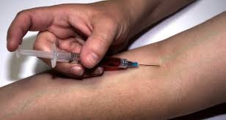
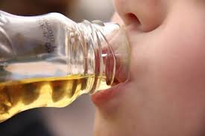
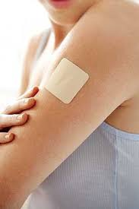
HOW DRUGS ENTER THE BODY
7-10 seconds | 10-30 seconds | 3-5 minutes | 15-35 minutes | 1-2 days
Notes:
In addition to knowing about drug classifications so we can avoid mixing, it’s also important to know how fast a drug is going to get into your body. What do you think? Let’s take guesses. Okay, now let’s take a look at what the answers actually are. Why might knowing this impact your decisions? Why does it matter?
Take student responses. Give own examples, ie edibles take a longer time to have impact. If someone is expecting a fast impact, they might take MORE, leading to an eventual response that is far greater than intended or an “overdose” or “overconsumption”. Injection—the changes in your body are almost immediate, meaning that any impact on your decision making ability or physical function happens almost immediately
Note to Facilitator:
Smoke or inhaled 7-10 seconds
Injected in vein 10-30 seconds
Mucus Membrane absorption (snort or under tongue) 3-5 minutes
Taken Orally – 20-30+ minutes – Edibles 45 min – 2 hours *These take longer because they must pass through the digestive system first
Skin or contact absorption - could be up to 1-2 days

Slide 6
HOW DRUGS ENTER THE BODY
7-10 seconds | 10-30 seconds | 3-5 minutes | 15-35 minutes | 1-2 days
Notes:
In addition to knowing about drug classifications so we can avoid mixing, it’s also important to know how fast a drug is going to get into your body. What do you think? Let’s take guesses. Okay, now let’s take a look at what the answers actually are. Why might knowing this impact your decisions? Why does it matter?
Take student responses. Give own examples, ie edibles take a longer time to have impact. If someone is expecting a fast impact, they might take MORE, leading to an eventual response that is far greater than intended or an “overdose” or “overconsumption”. Injection—the changes in your body are almost immediate, meaning that any impact on your decision making ability or physical function happens almost immediately
Note to Facilitator:
Smoke or inhaled 7-10 seconds
Injected in vein 10-30 seconds
Mucus Membrane absorption (snort or under tongue) 3-5 minutes
Taken Orally – 20-30+ minutes – Edibles 45 min – 2 hours *These take longer because they must pass through the digestive system first
Skin or contact absorption - could be up to 1-2 days

Slide 7
HOW DRUGS ENTER THE BODY
7-10 seconds | 10-30 seconds | 3-5 minutes | 15-35 minutes | 1-2 days
Notes:
In addition to knowing about drug classifications so we can avoid mixing, it’s also important to know how fast a drug is going to get into your body. What do you think? Let’s take guesses. Okay, now let’s take a look at what the answers actually are. Why might knowing this impact your decisions? Why does it matter?
Take student responses. Give own examples, ie edibles take a longer time to have impact. If someone is expecting a fast impact, they might take MORE, leading to an eventual response that is far greater than intended or an “overdose” or “overconsumption”. Injection—the changes in your body are almost immediate, meaning that any impact on your decision making ability or physical function happens almost immediately
Note to Facilitator:
Smoke or inhaled 7-10 seconds
Injected in vein 10-30 seconds
Mucus Membrane absorption (snort or under tongue) 3-5 minutes
Taken Orally – 20-30+ minutes – Edibles 45 min – 2 hours *These take longer because they must pass through the digestive system first
Skin or contact absorption - could be up to 1-2 days

Slide 8
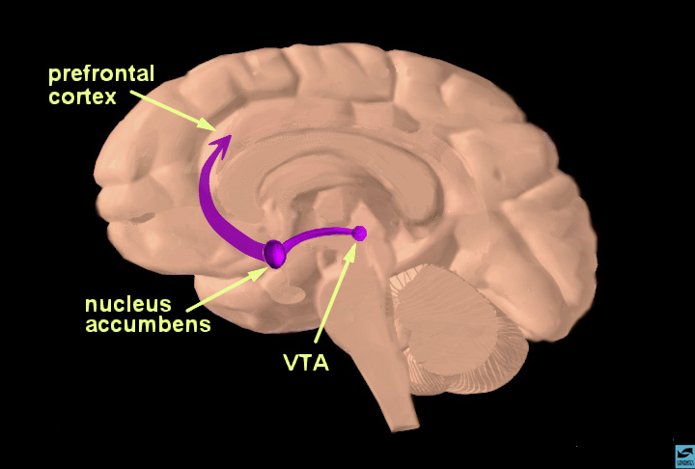
Addictive Substances and the Rewards/Learning Pathway
Activated by pleasurable stimuli. Examples—Love, success, your favorite meal, etc.
Addictive substances mimic those experiences.
Notes:
Addictive substances travel from the VTA (Ventral Tegmental Area) to the nucleus accumbens and then up to the prefrontal cortex, affecting each along the way.

Slide 9
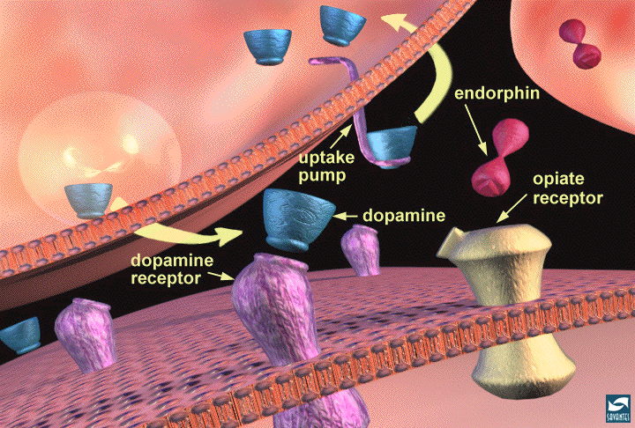
Stage 1: Tolerance
The brain defends itself against higher levels of dopamine or serotonin by blocking some neuro-receptors.
Result: Each time the addictive substance is taken, a higher dose is required to = the same effect.
Notes:
The addictive substance tricks the brain into thinking it’s good for survival by giving those dopamine or serotonin hits. Using these substances regularly before age 25 increases your chance of addiction significantly. After 25, the chance of addiction is lower, but the flip side is that people who started before 25 find it much harder to quit after 25 b/c the neural pathways solidify and addictive habits and mind set becomes harder to break. Learning pathways are the same as addiction, which is why you are in school.

Slide 10
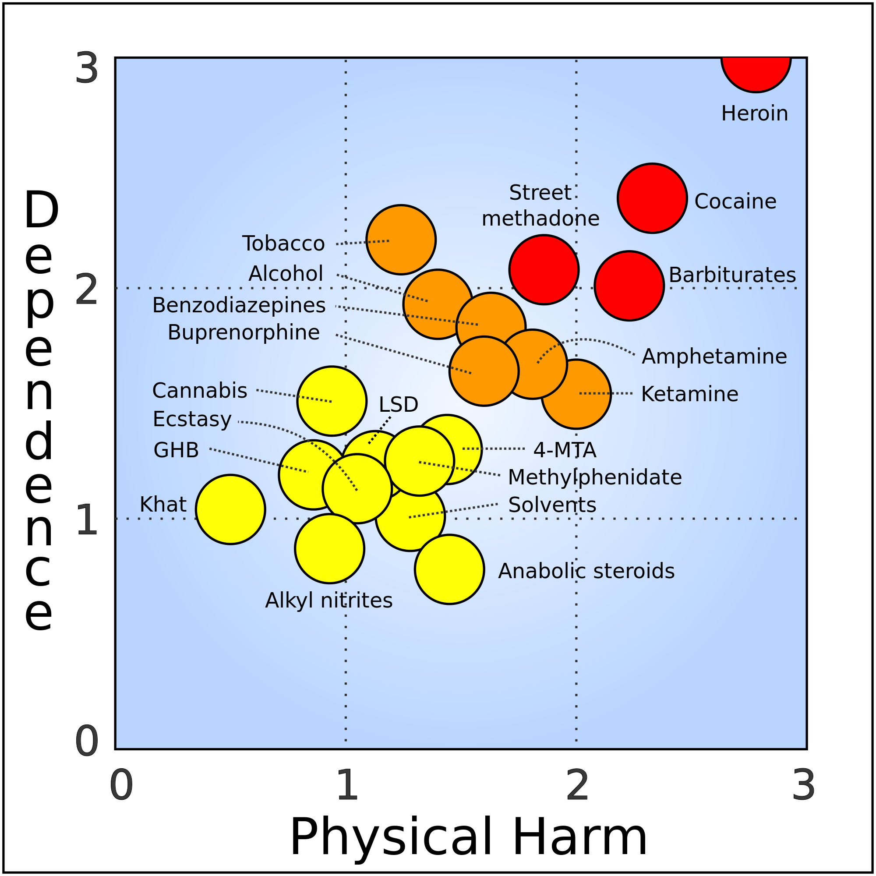
Stage 2: Dependence
The brain can only function normally with the substance.
Reduced pleasure from ordinary life.
Withdrawal symptoms.
Notes:
Caffeine—how many of you are dependent on it? Would you choose caffeine over your job? A relationship? Then you’re not addicted to it.

Slide 11
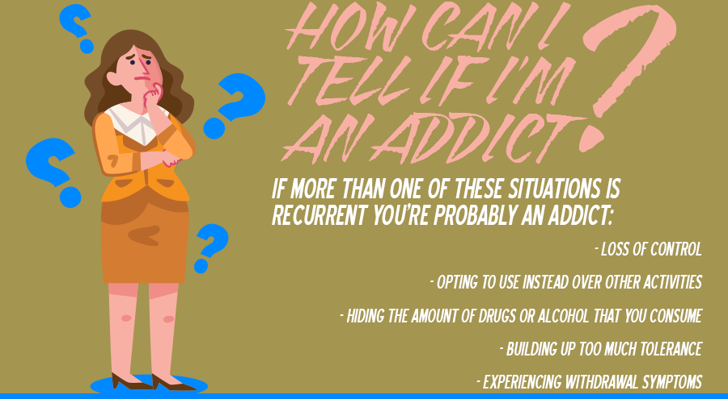
Stage 3: Addiction
Addiction: Continually engaging in a compulsive behavior, even when faced with negative consequences.
Loss of control over intake of the addictive substance.
Notes:
Culture of addiction. Romanticized, ritualized, slang + world view that draws a line vs. outsiders who don’t get it. An important difference between dependence and addiction: Someone with a painful terminal illness may become physically dependent on pain killers but is unlikely to construct any positive psychological associations with the drug or romanticize and ritualize its use. That person is therefore NOT technically addicted.

Slide 12
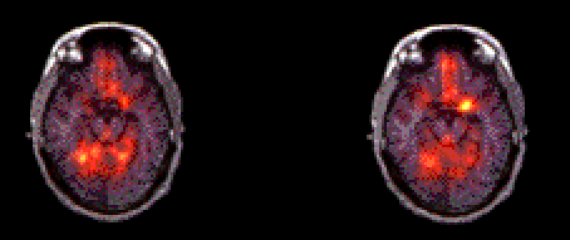
A Recovering Addict Thinks About Cocaine
Amygdala barely lit up
Amygdala activated
Nature Video
Cocaine Video
Even years into a recovery, the mere mention of cocaine or an image of cocaine use can trigger intense cravings on the part of an addict.

