Slide 1
Unit 1: Foundations of Democracy
Unit 1 Essential Questions: 1. Is there such a thing as one “best form of government” for all societies?
2. How did Greco-Roman political philosophy, monotheistic moral teachings, and political reforms in medieval England influence the development of democratic values?
Learning Target: I can explain how leaders of ancient Athens developed elements of a democratic political system and contrast it with Sparta’s military-centered society.
HW: 1. HW#1 (Due Block Day)
2. Study for Practice Quiz (Block Day).
3. Study for Quiz (Friday)
Notes:
Students are encouraged to ask online questions or write online comments about the discussion. Keep it classy though…
*Tyranny + dictatorship—A system of government in which one person or a small group of people have a monopoly on political decisions that is enforced through violence and intimidation.

Slide 2
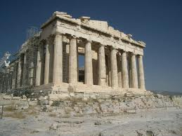
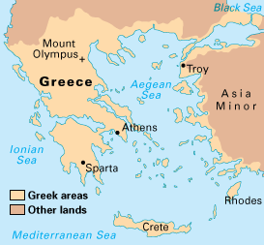
Ancient Greece: Athens vs. Sparta

Slide 3
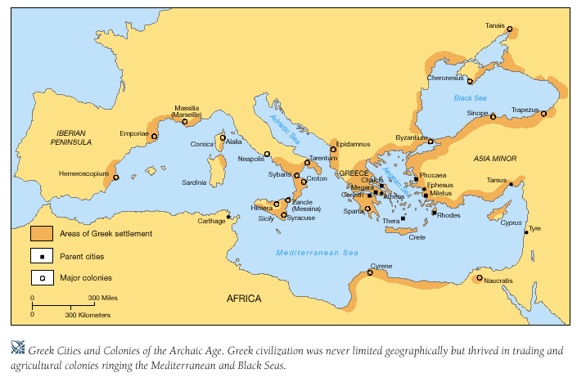
Greek city-states (700 – 323 B.C.E)

Slide 4
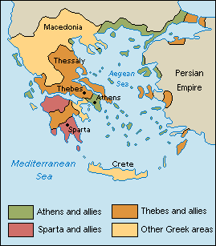
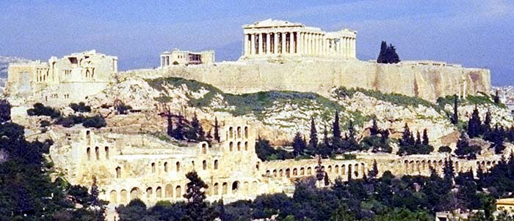
Athens: Direct Democracy: Citizens vote on every important decision. Sparta: Oligarchy (rule by the few)
Notes:
If a word is underlined, it’s probably a vocab word you will see again on assessments.

Slide 5
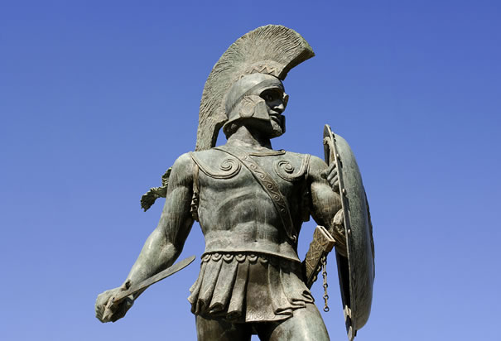
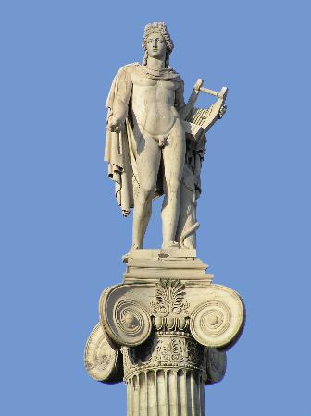
Partner/Share—Which values are the most important for a successful society?
Spartan Values
Strength
Duty
Sacrifice
Athenian Values
Individuality
Beauty
Freedom

Slide 6
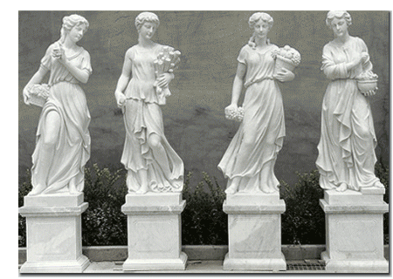
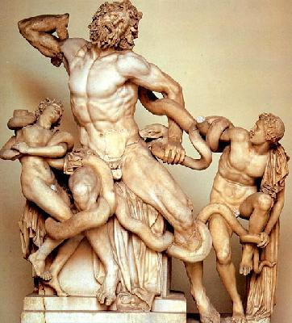
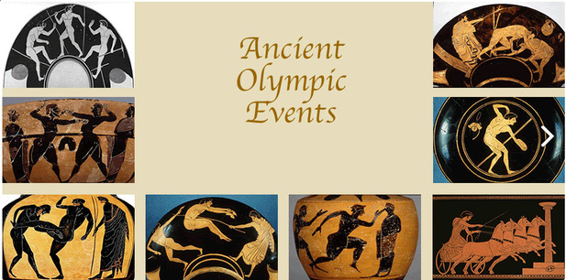
Athenian Culture:
Free exchange of goods + ideas.
Celebrated the beauty and abilities of the human body.

Slide 7
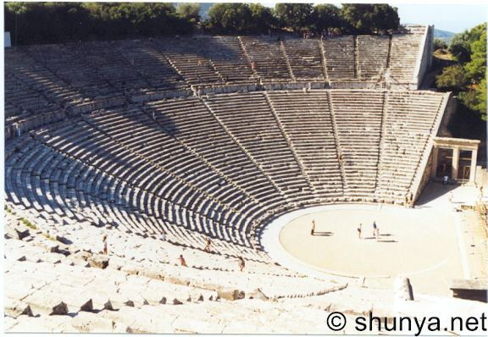
Athenian Government
Duties of the Citizen: All citizens had to vote and participate in debates.

Slide 8
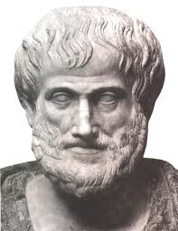
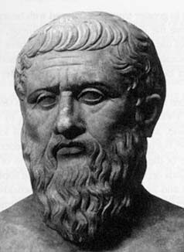
Athenian Philosophers
Aristotle—Societies should be ruled by the middle class. The rich are too greedy and the poor too irresponsible.
Plato—Societies should be ruled by philosopher kings: Specially trained leaders known for their wisdom and fairness.
PARTNER/SHARE: Which society would you rather live in? WHY?
Aristotle
384-322 B.C.E.
Plato
427-347 B.C.E.

Slide 9
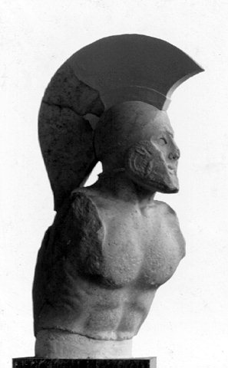
Sparta- A City of Warriors
Main focus: Preparing for war.
Why so strict? A slave revolt led them to demand total obedience to the state.
Limited artistic culture.
Closed to the outside world.

Slide 10
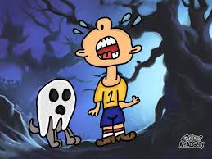
Education
At 7, boys and girls began physical training.
At 13, dropped off in the woods with nothing. They had to make it home alive to pass.
Could you have passed that test at age 13?

Slide 11
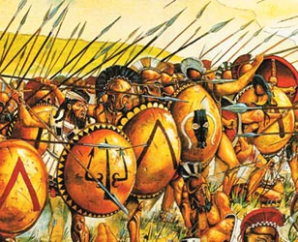
Military
Men married at the age of 20.
Lived in barracks for ten years.

Slide 12
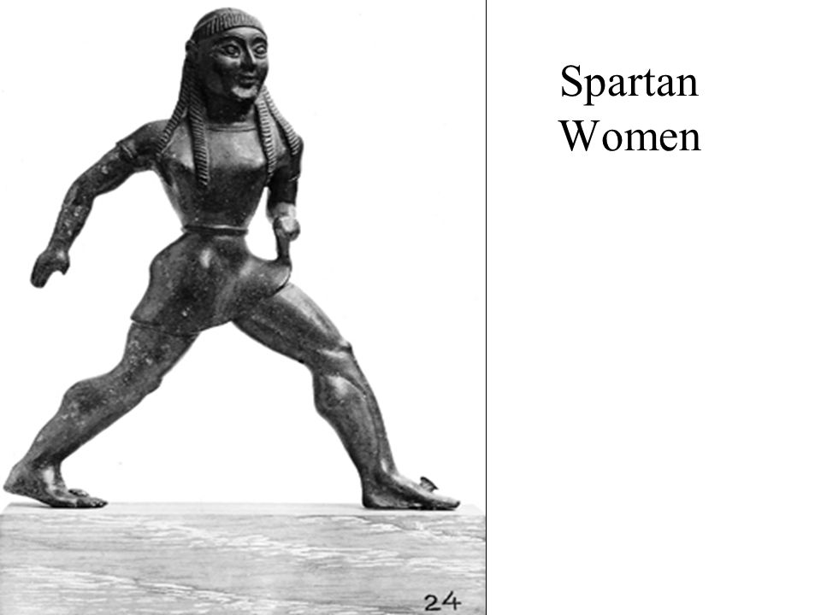
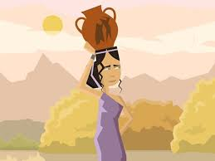
Women in Sparta/Athens
A Spartan mother would say to her son as he goes off to war: “Return with your shield, or on it.”
Trained with boys: Fit women produced fit male warriors.
Equal property rights: So many men died in battle, many women ended up running businesses, farms, etc.
In Athens, women had few property rights and no political rights.

Slide 13
PARTNER/SHARE
Which society would you rather live in—Athens or Sparta? WHY?

